Slide 1

TalkSite AI Journey – Assignment 1
Automated Markdown Validation Agent
Submitted By: Patan Masthan
Role: Full Stack Web Developer
Technology: Python + Agno AI Framework

Slide 2
PROJECT VISION
Defining Our AI Automation Journey
1
2
3
Learn AI Agent Concepts
Build a Working Automation Project
Automate Markdown Validation
Grasp the fundamental principles and architecture of AI agents.
Develop a practical, functional AI-driven automation solution.
Implement automated checks for common Markdown syntax errors.
4
5
Detect Errors & Suggest Fixes
Demonstrate with UI/Terminal
Identify issues and provide intelligent, actionable recommendations.
Showcase the project's capabilities through intuitive interfaces.

Slide 3

The Challenge: Ensuring Markdown Quality
Problem Statement
Our AI-Powered Solution
Markdown files, while versatile, are prone to specific errors that can degrade content quality and user experience:
To address this, we developed an AI Agent specifically designed to:
Automatically scan and analyze Markdown files.
Proactively identify validation errors.
Generate precise and actionable corrections.
Incorrect heading syntax (e.g., missing spaces).
Broken links or malformed URLs.
Unclosed bold/italic formatting.
General formatting inconsistencies.
Manual validation of these issues is a time-consuming and error-prone process.
This transforms a tedious manual task into an efficient, automated workflow.

Slide 4


FUNDAMENTALS
Understanding the AI Agent Architecture
Decision
Auto Output
Input
Tool Use
An AI Agent is an autonomous software entity capable of perceiving its environment, making decisions, and performing actions to achieve specific goals.
In this project, our AI Agent acts as an intelligent orchestrator, controlling the validation process and presenting clear, actionable results to the user.

Slide 5


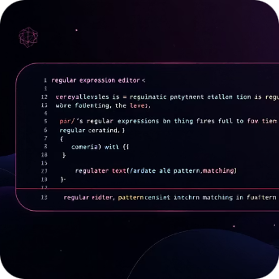


TOOLING
Core Technologies Driving the Project
Python
Agno AI Framework
Text Pattern Logic
Flask (Optional)
The foundational language for project execution and file manipulation.
The backbone for managing and orchestrating the AI agent's workflow and decisions.
Provides a lightweight web server for an optional, user-friendly file upload interface.
Utilized for precise detection of various Markdown syntax errors.
HTML & CSS
Employed for crafting the intuitive and responsive user interface.

Slide 6
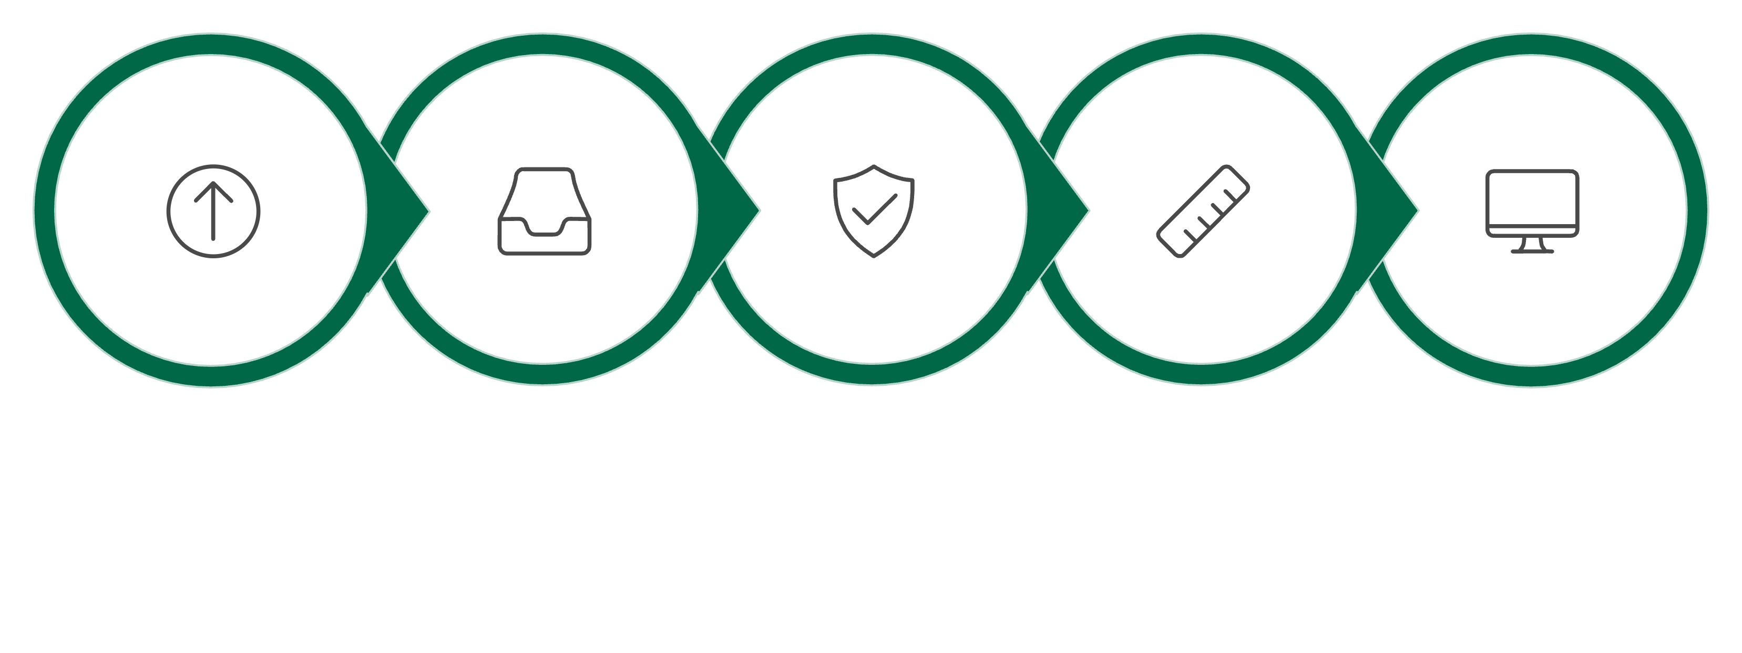
PROCESS FLOW
Seamless Markdown Validation Workflow
User Uploads
Agent Receives
Calls Validator
Validator Checks
Results Displayed
Our system ensures a smooth and efficient process from file submission to the presentation of validated results.

Slide 7
CAPABILITIES
Key Features of the Validation Agent
Reads .md Files
Designed to process standard Markdown files efficiently.
Detects Heading Errors
Identifies incorrectly formatted headings (e.g., missing spaces or incorrect levels).
Detects Bold/Italic Mistakes
Flags unclosed or improperly nested bold and italic syntax.
Detects Invalid Links
Recognizes malformed URLs or inaccessible link targets.
Suggests Corrections
Provides intelligent and context-aware suggestions for fixing identified issues.
Generates Issue List
Compiles a comprehensive report of all detected errors for easy review.
Optional Web Interface
Offers a user-friendly web-based frontend for convenient file uploads and result viewing.

Slide 8
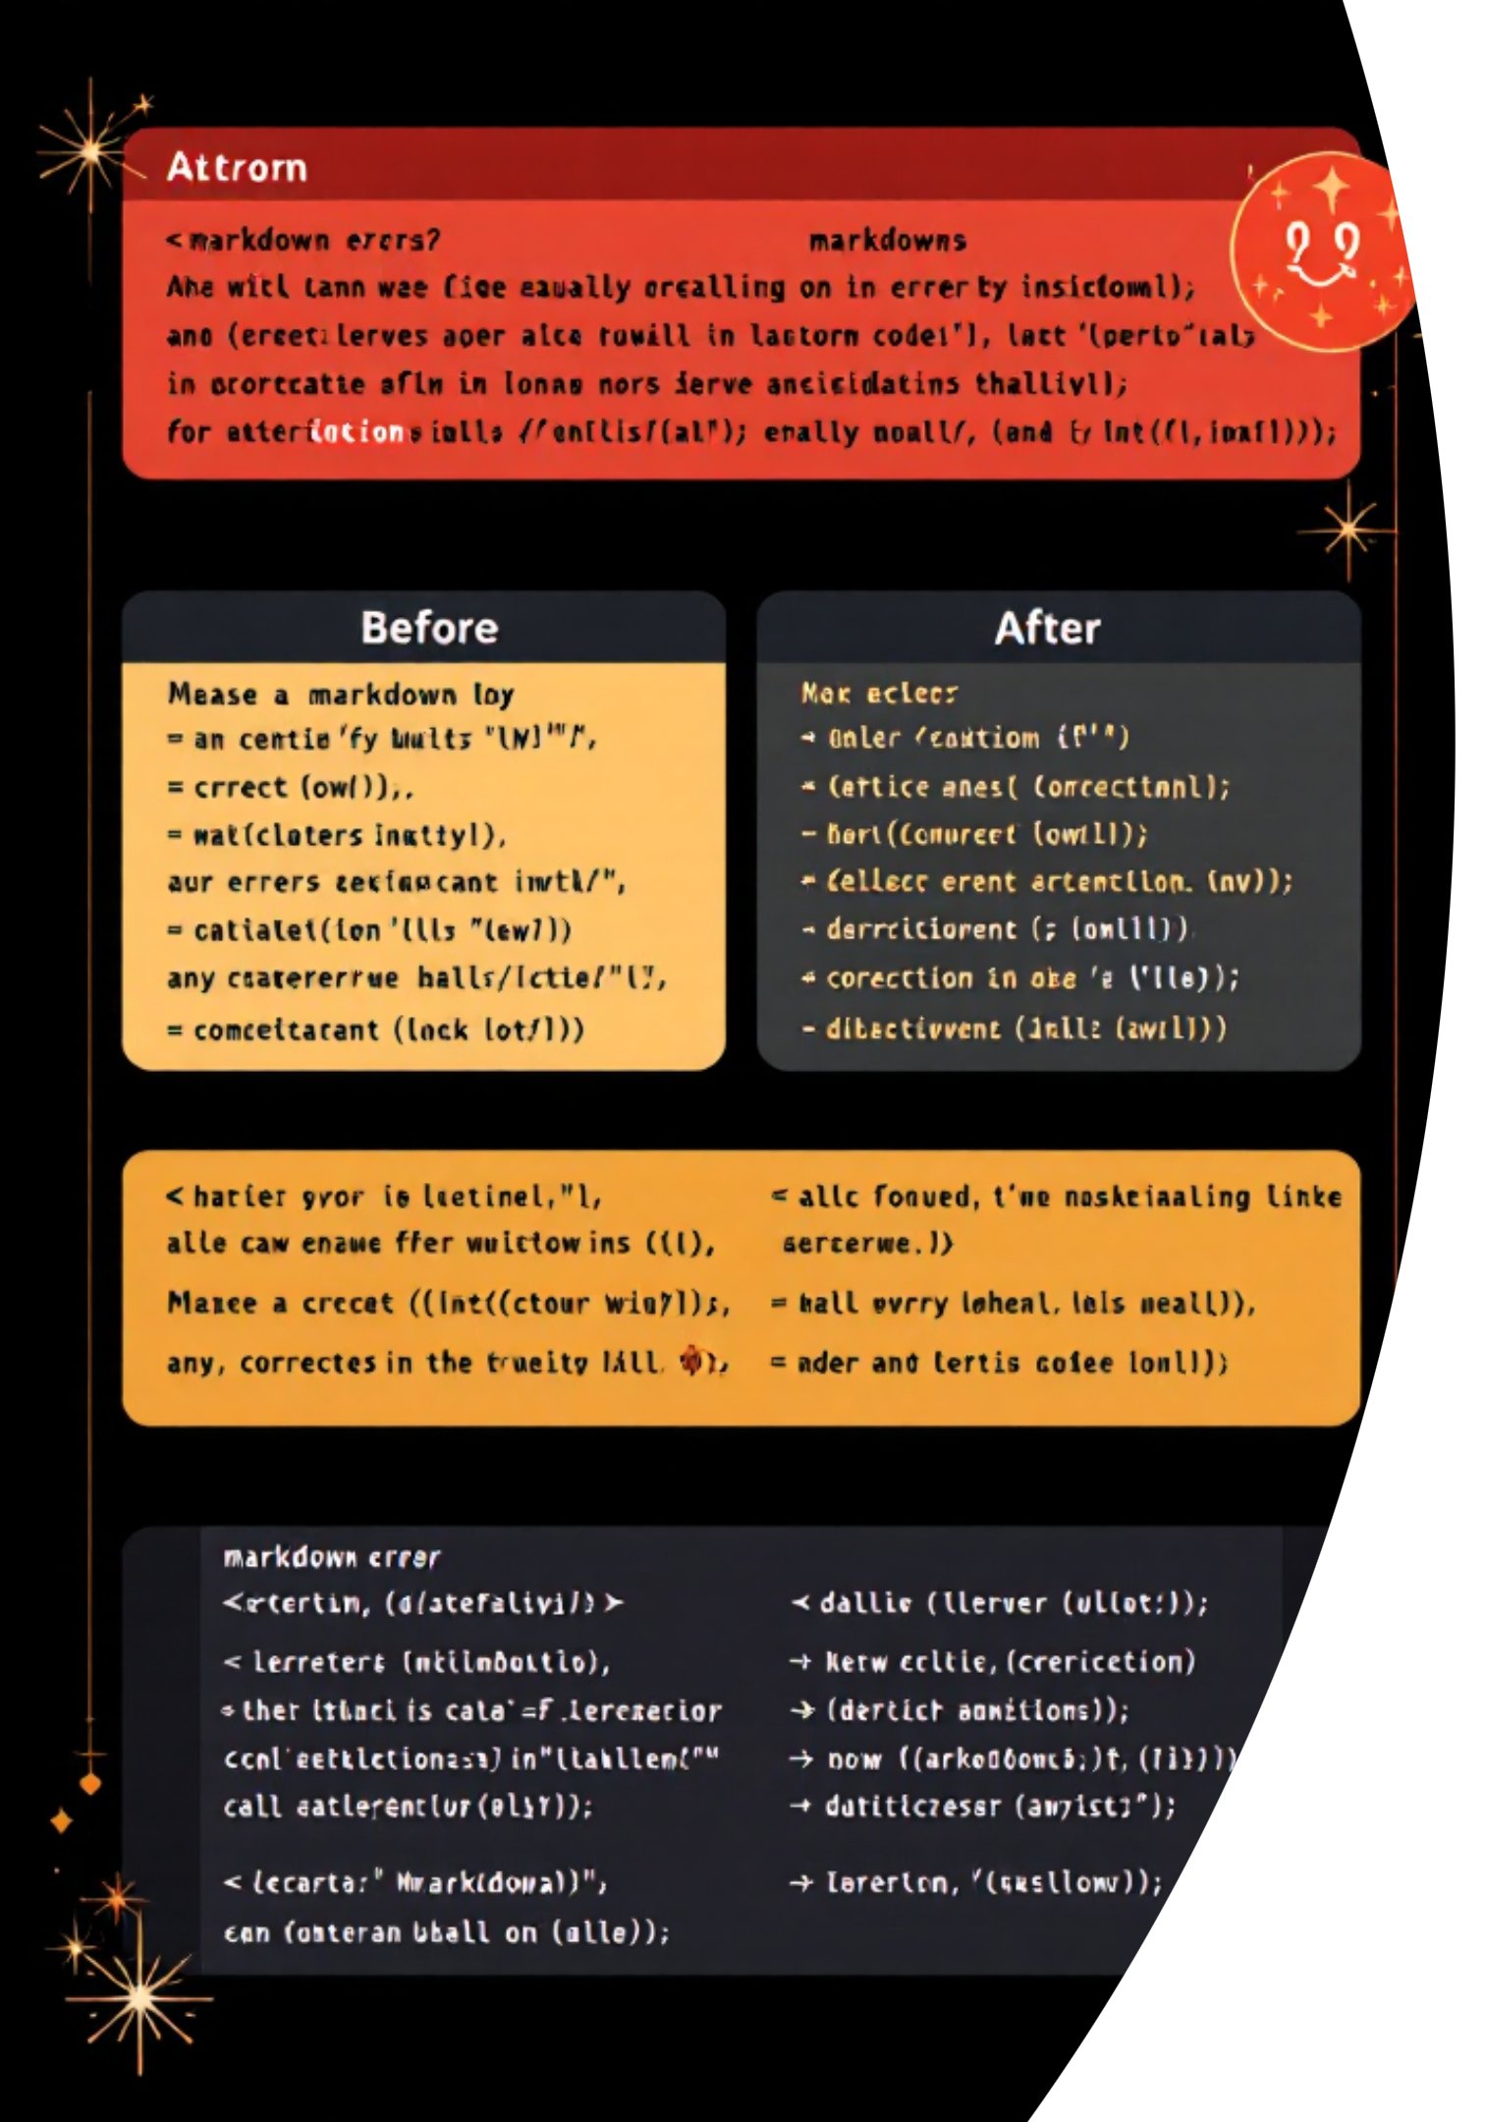
Illustrative Error Detection and Correction
Input Issues Found
Output Suggestions Provided
#Heading → Missing space after the hash symbol.
**bold text → Unclosed bold syntax, leading to improper rendering.
[Google](htp://google.com) → Invalid protocol in the URL.
_italic text → Missing closing underscore for italic formatting.
Suggestion: # Heading – Always add a space after the hash for correct heading format.
Suggestion: **bold text** – Ensure all formatting tags are properly closed.
Suggestion: [Google](https://google.com) – Correct the URL protocol to a valid one like https.
Suggestion: _italic text_ – Complete the italic formatting with a closing underscore.

Slide 9

Overcoming Development Hurdles
Challenges Faced
Effective Solutions Implemented
File Encoding Issues: Inconsistent character sets led to parsing errors.
Pattern Matching Accuracy: Developing robust regular expressions for varied Markdown syntax.
Agent Integration Logic: Seamlessly connecting the validation tool with the AI agent workflow.
UI Improvement: Designing an intuitive and responsive user experience.
UTF-8 Encoding: Standardized all file I/O to UTF-8 to handle diverse character sets.
Simple Text Rules: Focused on precise, well-tested regular expressions for high accuracy.
Modular Python Structure: Developed a clean, modular codebase for easier integration and maintenance.
Iterative UI/UX Design: Conducted continuous feedback loops to refine the user interface.

Slide 10
The Road Ahead: Future Enhancements
AWS Cloud Deployment
Multiple File Upload
PDF Validation
Transition to a scalable, production-ready cloud environment.
Enable bulk processing of several Markdown files simultaneously.
Expand validation capabilities to include PDF document analysis.
Advanced AI Grammar Checking
User Login System
Integrate more sophisticated AI models for contextual grammar and style checks.
Implement secure user authentication for personalized experiences and data management.

